Slide 1
2019 Phonics Check Practice Words

Slide 2
Real

Slide 3
Real

Slide 4
Real

Slide 5
Real

Slide 6
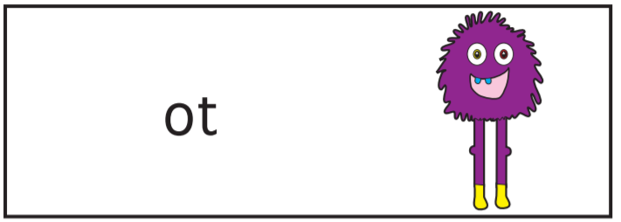
Pseudo

Slide 7
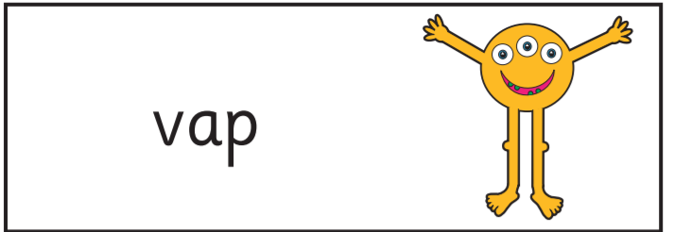
Pseudo

Slide 8
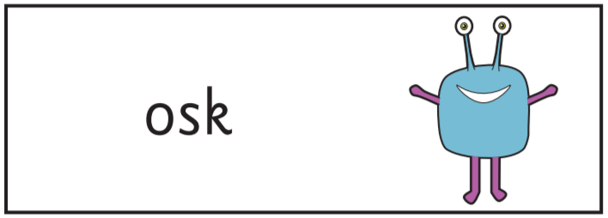
Pseudo

Slide 9
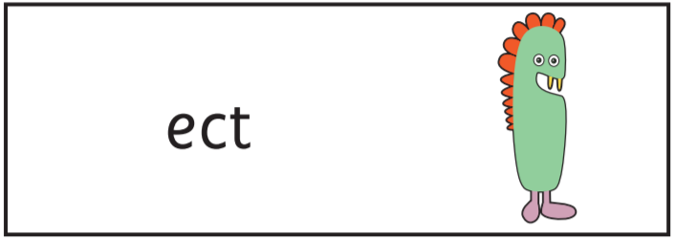
Pseudo

Slide 10
2019 Phonics Check Section 1

Slide 11
1
Pseudo

Slide 12
2
Pseudo

Slide 13
3
Pseudo

Slide 14
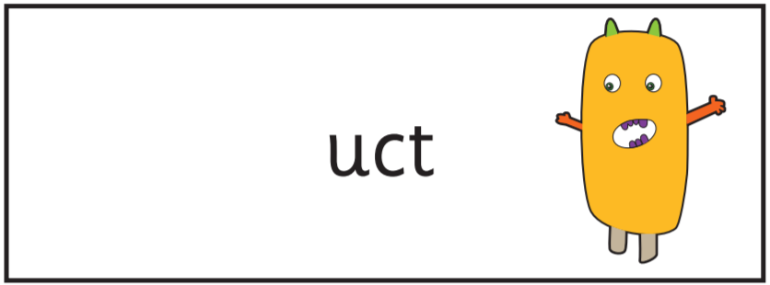
4
Pseudo

Slide 15
5
Pseudo

Slide 16
6
Pseudo

Slide 17
7
Pseudo

Slide 18
8
Pseudo

Slide 19
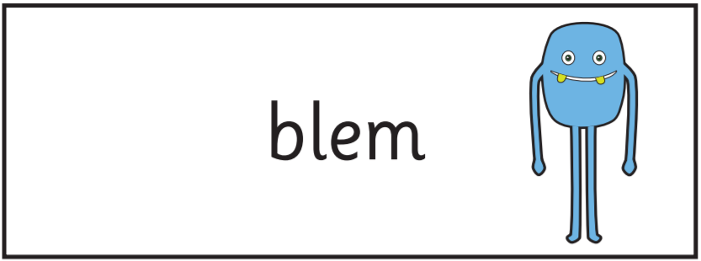
9
Pseudo

Slide 20
10
Pseudo

Slide 21
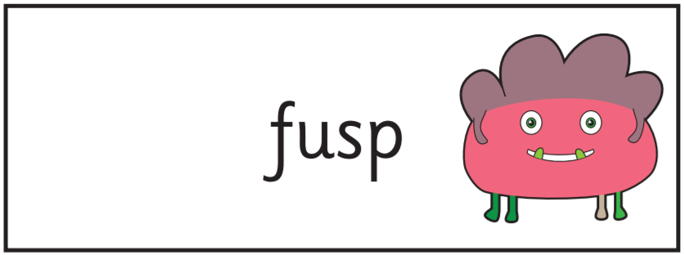
11
Pseudo

Slide 22
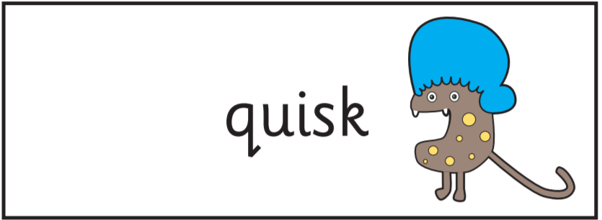
12
Pseudo

Slide 23
13
Real

Slide 24
14
Real

Slide 25
15
Real

Slide 26
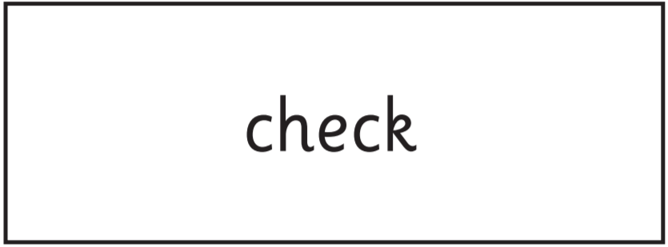
16
Real

Slide 27
17
Real

Slide 28
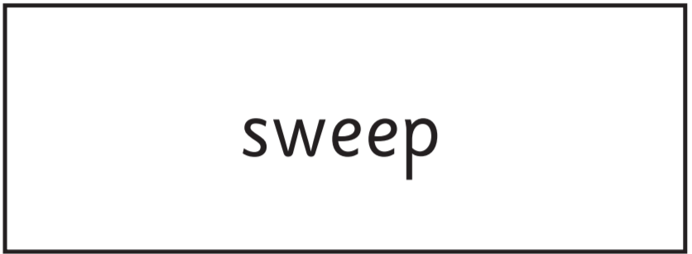
18
Real

Slide 29
19
Real

Slide 30
20
Real

Slide 31
2019 Phonics Check Section 2

Slide 32
21
Pseudo

Slide 33
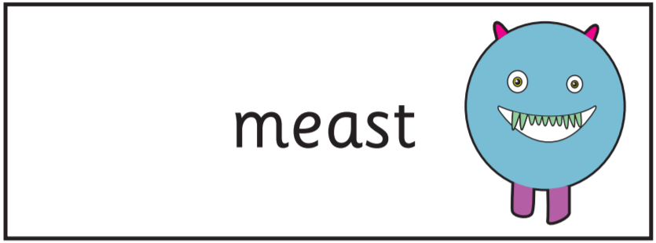
22
Pseudo

Slide 34
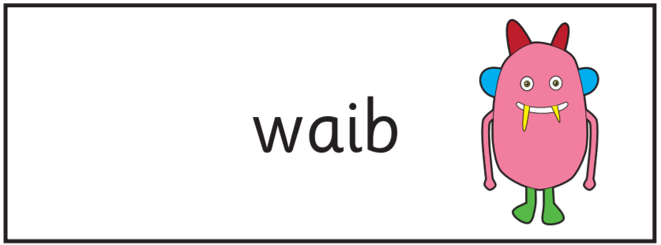
23
Pseudo

Slide 35
24
Pseudo

Slide 36
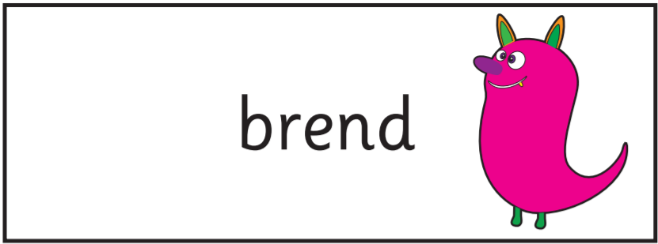
25
Pseudo

Slide 37
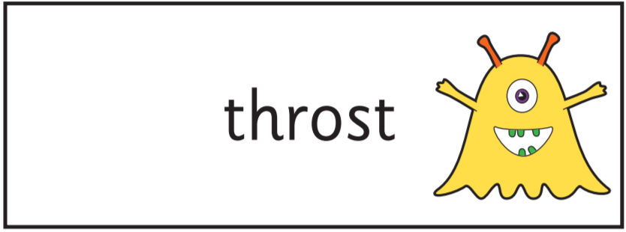
26
Pseudo

Slide 38
27
Pseudo

Slide 39
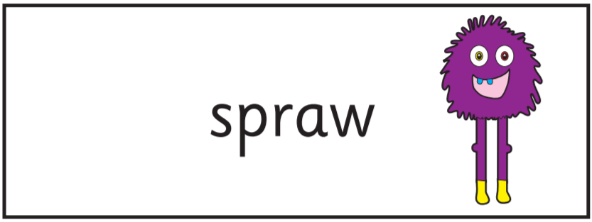
28
Pseudo

Slide 40
29
Real

Slide 41
30
Real

Slide 42
31
Real

Slide 43
32
Real

Slide 44
33
Real

Slide 45
34
Real

Slide 46
35
Real

Slide 47
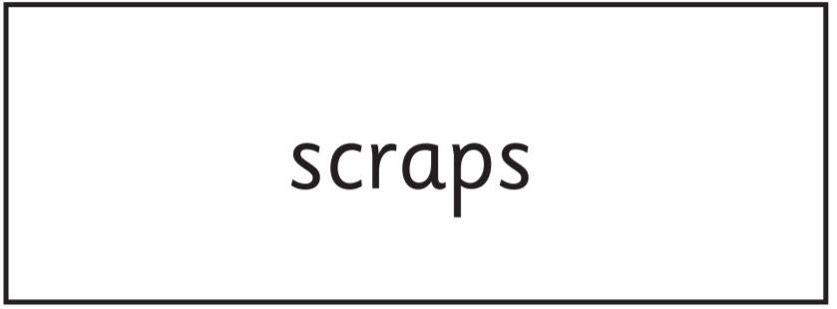
36
Real

Slide 48
37
Real

Slide 49
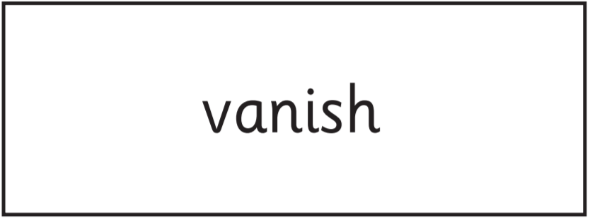
38
Real

Slide 50
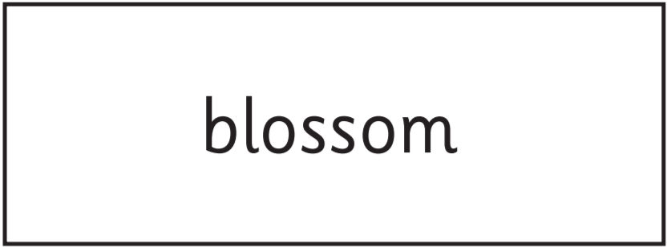
39
Real

Slide 51
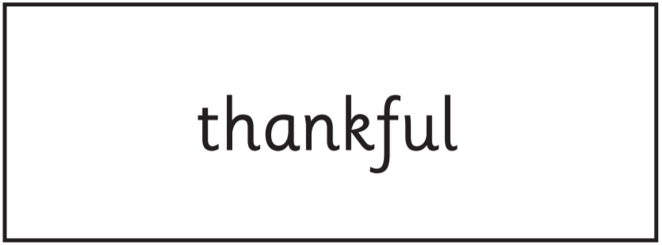
40
Real

Slide 52
2019 Phonics Check End

